Slide 1
ENHANCING CONCRETE STRUCTURAL DESIGN: PREDICTIVE MODELING FOR TENSILE STRENGTH EVALUATION
Nelly Nkirote E033-01-2339/2020
Joseph Gathithi Wathome E033-01-1386/2020
Supervisor
Dr. ERASTUS KAROKI

Slide 2
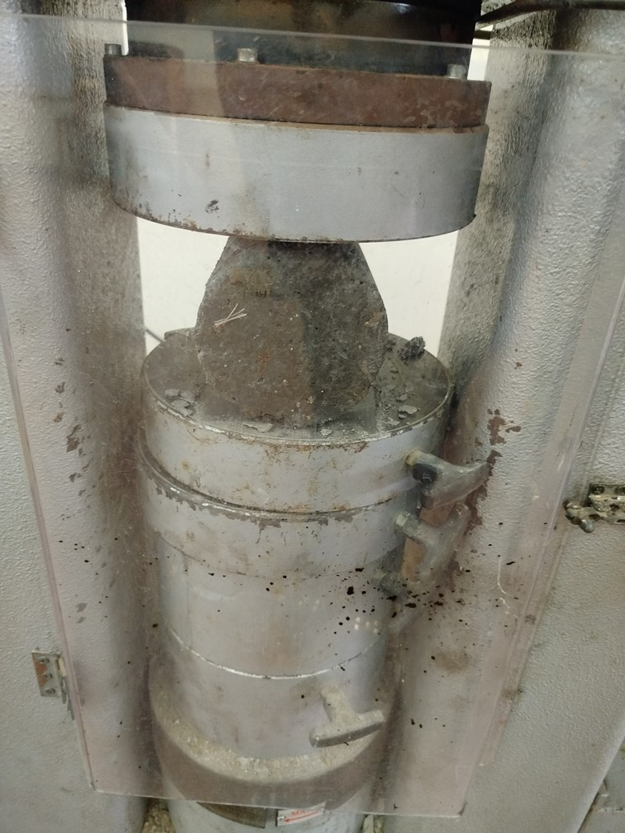
INTRODUCTION
Predict concrete strength using PyTorch.
Consider cement type, water content, admixture,
curing time, and aggregates.
Model tested on 20% data and extra lab samples.
Aim is to enhance civil engineering practices.
Split Tensile Testing

Slide 3
PROBLEM STATEMENT
This project proposed a Python-based neural network model to predict concrete's tensile strength, aiming to enhance efficiency and accuracy in civil engineering practices.
RESEARCH GAP
Currently Gaining Grounds in Kenya
Need for More Accurate Predictions
Need for Real-World Validation
Notes:
2 STATEMENT OF THE PROBLEM
The tensile strength of concrete is critical for the durability and integrity of structures. However, current methods to determine this are labor-intensive, time-consuming, and may lack precision. Additionally, it’s a misconception that high compressive strength guarantees high tensile strength. This project proposes to develop a Python-based neural network model to accurately predict concrete’s tensile strength, aiming to reduce testing time and costs, and enhance the efficiency of ensuring the quality and durability of concrete structures.

Slide 4
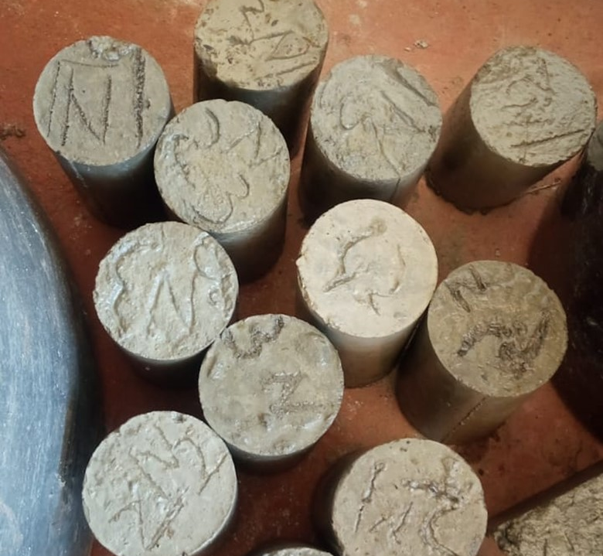
LIMITATION OF STUDY
The accuracy of our concrete tensile
strength prediction model depends on: data
availability, model complexity, generalizability,
and underlying assumptions.
Sample Examples

Slide 5
METHODOLOGY
Data Collection & Processing
Feature Selection
Model Development (Tensile Predictor)
Loss Function
& Model Optimization
Training Process
Evaluation Process
Model Refinement & Saving
Documentation & Reporting

Slide 6
OBJECTIVE
Develop a Python-based neural network model using PyTorch to accurately predict concrete tensile strength in civil engineering application.
SPECIFIC OBJECTIVES
Consolidate essential parameters including cement type, curing duration, aggregate size, water content, and types of admixtures
Construct and train a PyTorch neural network model specifically tailored to predict concrete tensile strength
Test the model with 20% data and three lab datasets, compare outputs with lab results, and refine accuracy by adjusting nodes, layers, weights, and biases

Slide 7
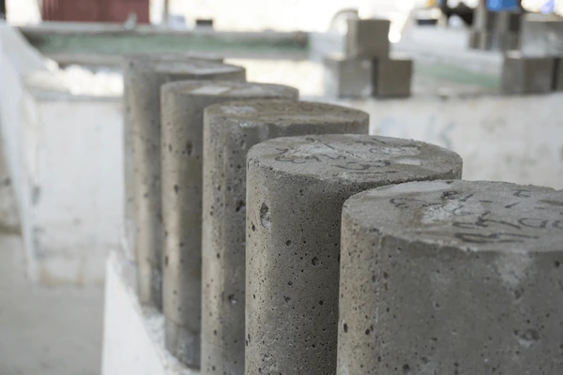
Specific objective 1 Consolidate essential parameters including cement type, curing duration, aggregate size, water content, and types of admixtures
DATA COLLECTION & PROCESSING
Prepared, cured, and tested concrete samples with varying parameters, recording the features and tensile strength for each of the 27 Samples.
Preprocessed and partition the collected data for use in the neural network model.

Slide 8
Specific objective 1 DATA COLLECTION
Cement Type | Admixture | Cement-Water Ratio | Aggregate Size
OPC | Air-Entraining | 0.45 | 5mm
KP Silver | -- | 0.50 | 10mm
White Cement | -- | 0.60 | 20mm
27 LAB SAMPLES

Slide 9
Specific objective 1
FEATURE SELECTION
We optimized critical parameters, including cement-water ratios, cement type, aggregate size, admixtures, and curing duration, through data preprocessing. This involved removing blank rows and explicitly labeling rows without admixtures as ‘No admixture’.
By Applying normalization to the features we optimized the models intergration and learning speeds This resulted in less time for training.

Slide 10
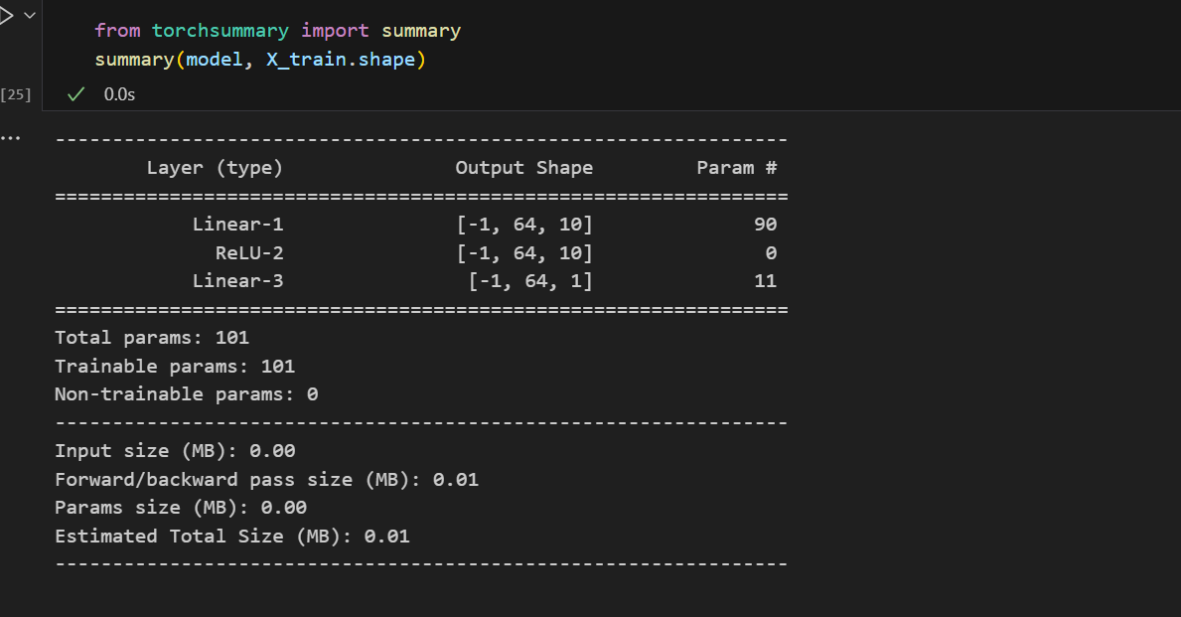
Specific objective 2 Construct and train a PyTorch neural network model specifically tailored to predict concrete tensile strength
MODEL DEVELOPMENT (TENSILE PREDICTOR)
We had 2 layers and 10 hidden layers and had a function in between the layers that acted as the Gatekeeper in the model for deciding which features to move forward and which to be eliminated.
Notes:
loss function, like Mean Squared Error or Mean Absolute Error

Slide 11
Specific objective 2
Why Neural Network with PyTorch
PyTorch: Powerful & flexible for neural networks.
Supports customization & pre-trained models.
Strong community support & easy experimentation.
Scalable & provides interpretability techniques.

Slide 12
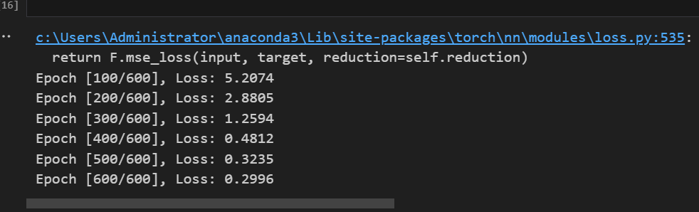
Specific objective 2
TRAINING PROCESS
We trained our model on 80% of the data using PyTorch, with the Adam optimizer and Mean Squared Error loss function for efficient learning and error minimization. We used 600 epochs.

Slide 13
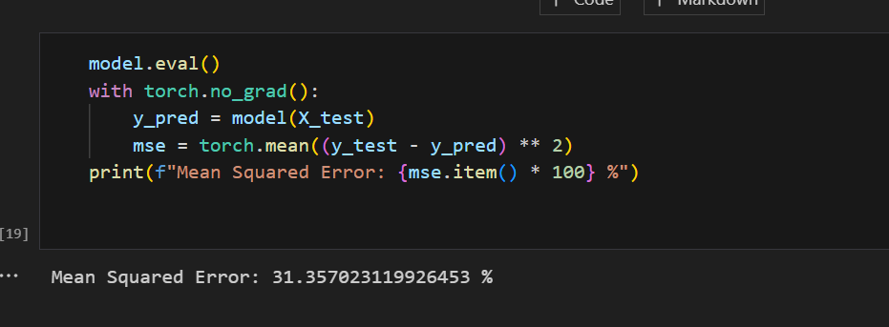
Specific objective 3 Test the model with 20% data and three lab datasets, compare outputs with lab results, and refine accuracy by adjusting nodes, layers, weights, and biases
EVALUATION PROCESS
Post-training, we evaluated our model on the remaining 20% of the data, achieving a Mean Squared Error of 31.36%.

Slide 14
Specific objective 3 PREDICTION
For further validation, we tested our model using 3 additional samples from the lab.
Sample | Actual Tensile Strength (MPa) | Predicted Tensile Strength (MPa) | Percentage Accuracy (%)
1 | 2.047115 | 2.04123 | 99.71
2 | 3.013026 | 1.61632 | 46.34
3 | 2.21254 | 1.72041 | 77.76

Slide 15
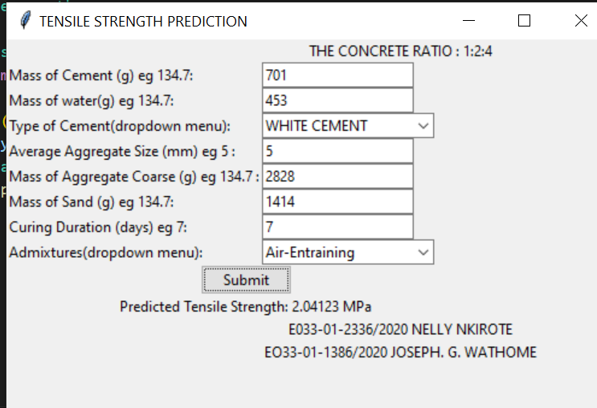
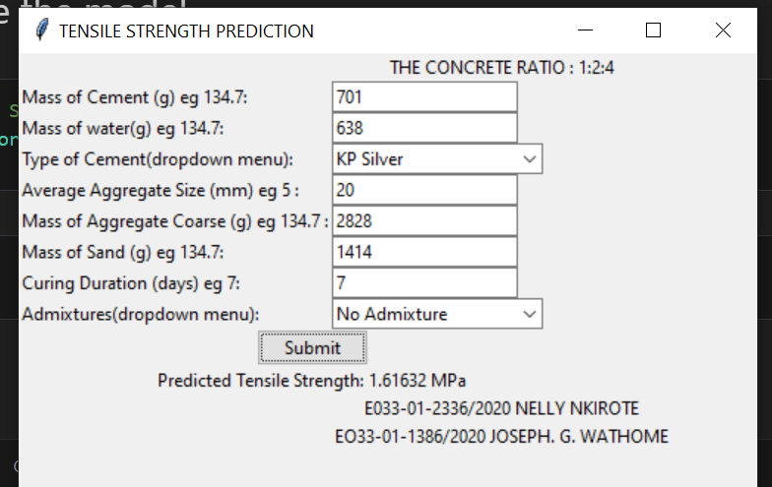
Specific objective 3 results

Slide 16
CONCLUSION
In conclusion, data collection was pivotal for our project. We gathered diverse data using Microsoft Excel, ensuring its cleanliness and accuracy.
Our study focused on factors affecting tensile strength, utilizing three cement types. However, time constraints limited data collection, and using only one admixture restricted data diversity.
In summary, while our model’s performance was satisfactory given the data we had, although there is potential for improvement. By diversifying data and dedicating more time to collection, future iterations can be more accurate. . Despite challenges, our commitment to refining the model remains strong.

Slide 17
RECOMENDATION
For future projects, we recommend:
Diversify Data: Include more cement types and admixtures for a comprehensive dataset.
Allocate More Time: Extend data collection time for a more robust dataset.
Ensure Material Availability: Secure a steady supply of materials to prevent disruptions

Slide 18
Work plan
MONTH | OCTOBER 2023 | NOVEMBER 2023 | DECEMBER 2023
WEEK
Selection of the project
Introduction
Literature review
Methodology and expected results
Final Project proposal presentation

Slide 19
Work plan
MONTH | JANUARY 2024 | FEBRUARY 2024 | MARCH 2024 |  |  |  | APRIL 2024
WEEK |  |  | 1 | 2 | 3 | 4
Project Research
Material Gathering
Project Progress Presentation 2
Data Collection
Model Development
Model Training
Model Prediction
Documentation

Slide 20
THE END

